Slide 1
Artificial Neural Network, Activation Functions, Loss Functions, Model Optimization, Result Analysis
Instructor: Prof. Tzuhsiung (Nick) Yang
Email: tyang@mx.nthu.edu.tw
Time: M5/6
Room: NTHU Library Comp Lab II
Notes:
Rafael Gomez

Slide 2
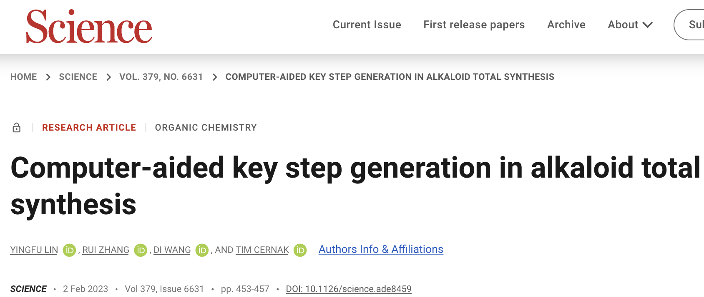
Computer-aided Synthetic Planning (CASP)

Slide 3

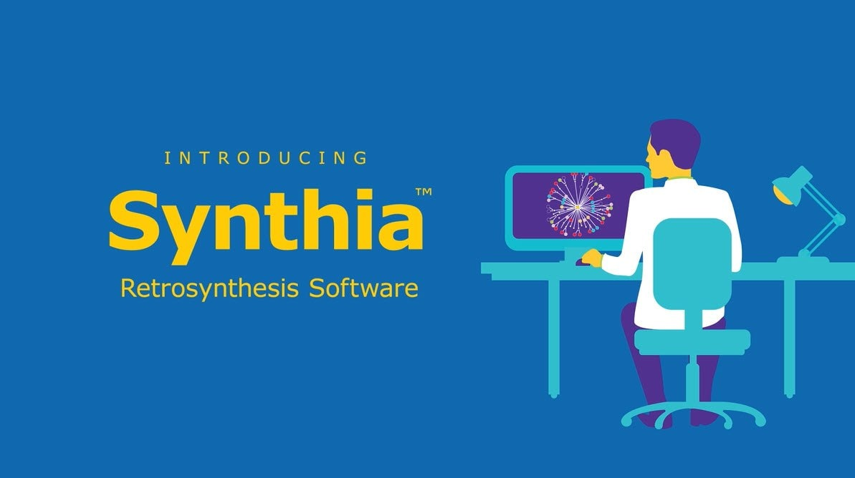
CASP

Slide 4
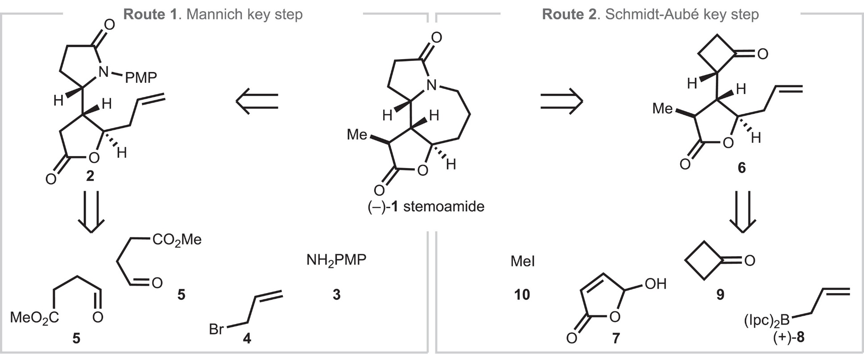
CASP

Slide 5
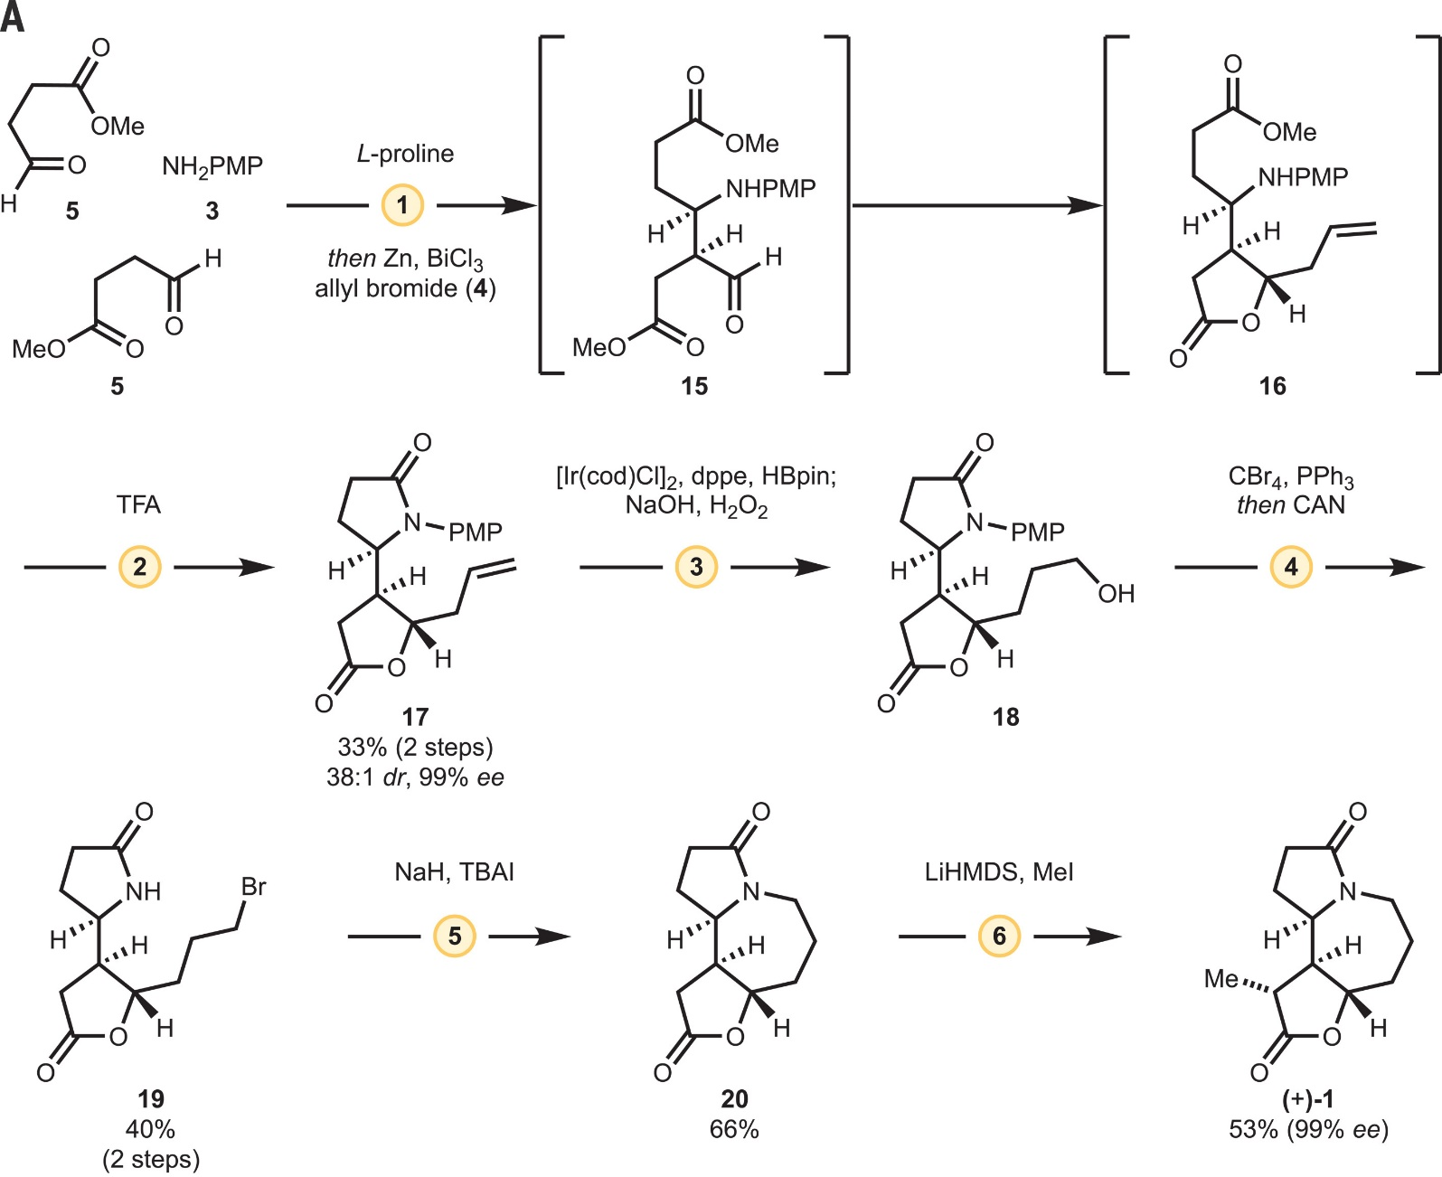
CASP

Slide 6
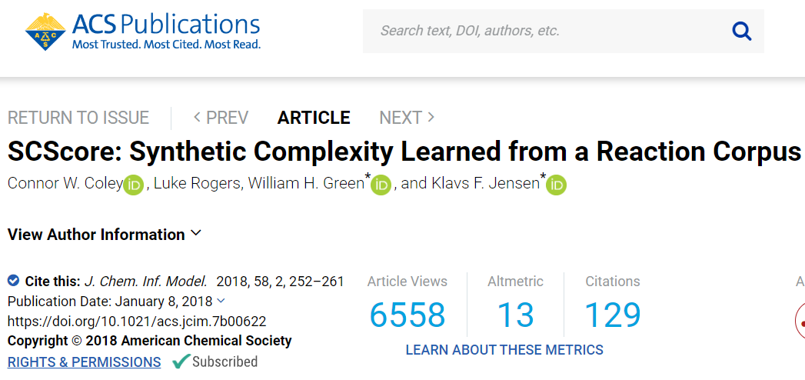

Slide 7
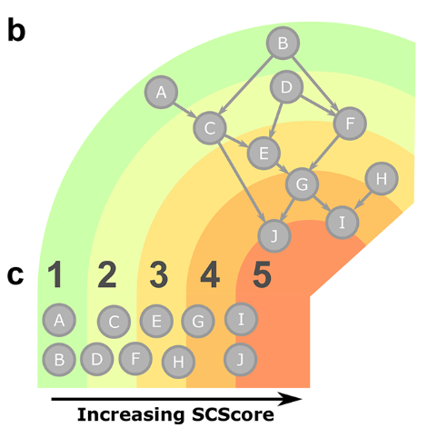
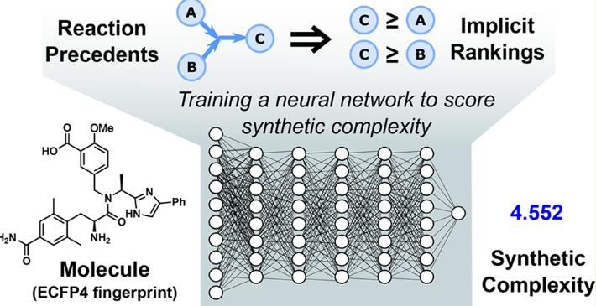
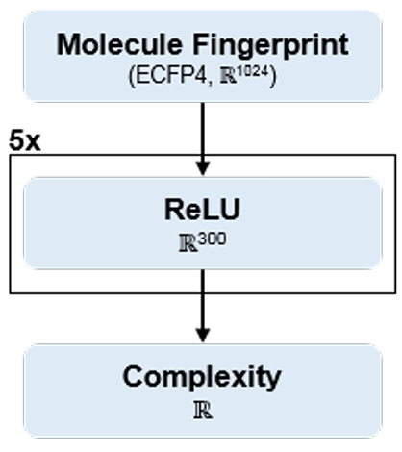

ML meets OrgChem
Coley, C. W.; Rogers, L.; Green, W. H.; Jensen, K. F. SCScore: Synthetic Complexity Learned from a Reaction Corpus. J. Chem. Inf. Model. 2018, 58, 252

Slide 8
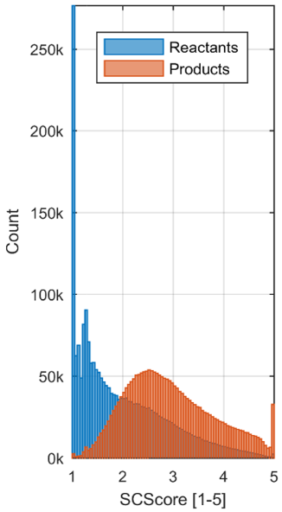
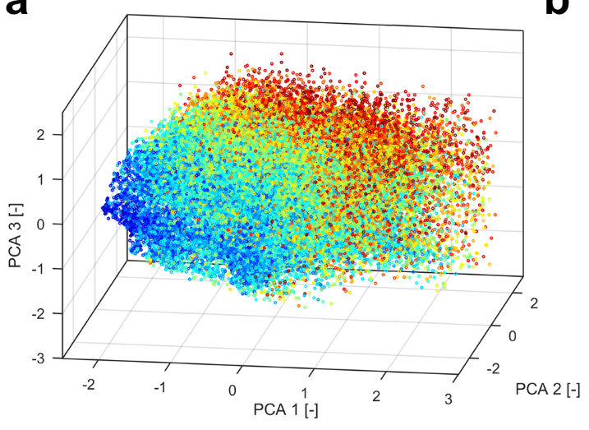
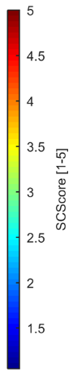
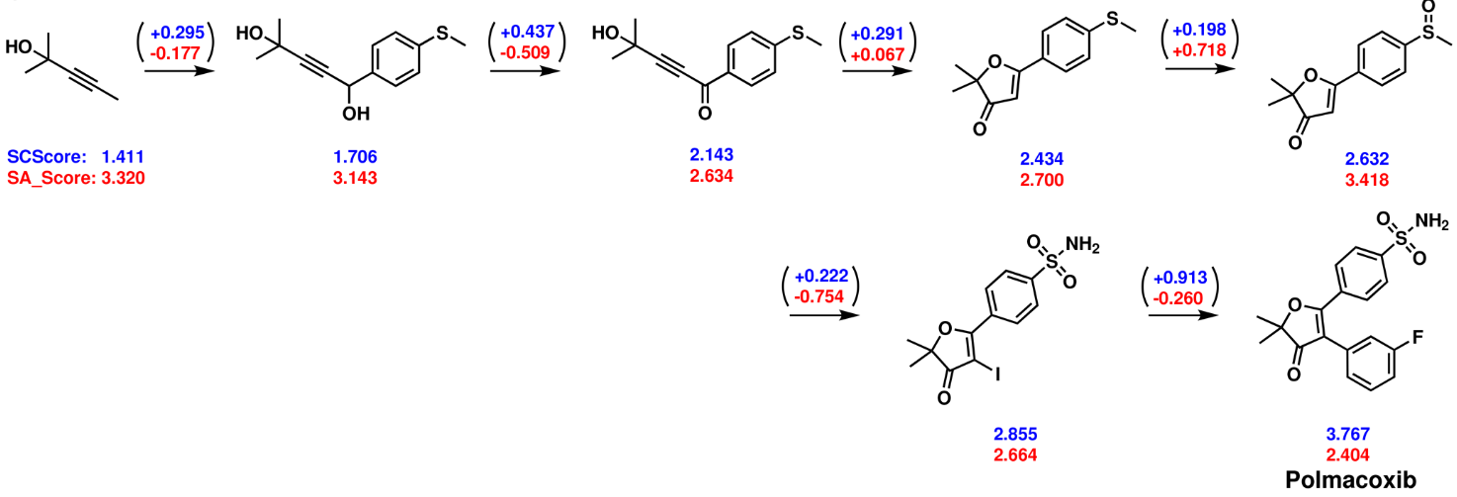
ML meets OrgChem
Coley, C. W.; Rogers, L.; Green, W. H.; Jensen, K. F. SCScore: Synthetic Complexity Learned from a Reaction Corpus. J. Chem. Inf. Model. 2018, 58, 252

Slide 9
Interactive
Go to Week13/Exercise1
git clone https://github.com/connorcoley/scscore.git
cd scscore
python scscore/standalone_model_numpy.py
Now change the smiles in standalone_model_numpy.py to the smiles in smis.smi by:
cat ../../smis.smi | sed "s/^/'/g" | sed "s/$/',/g”
replace the smiles in the script by the printed smiles.

Slide 10
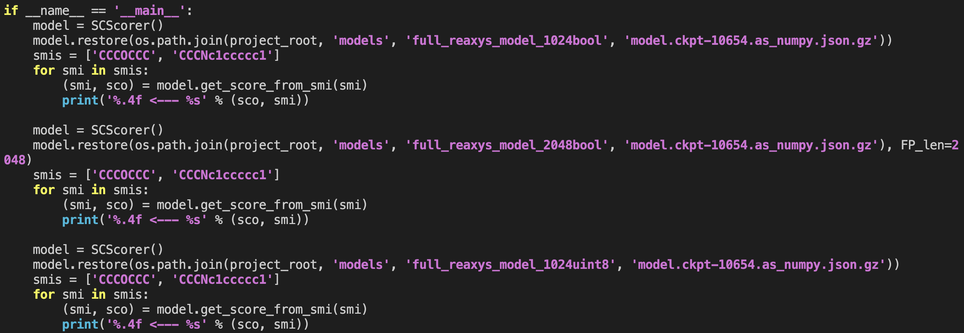
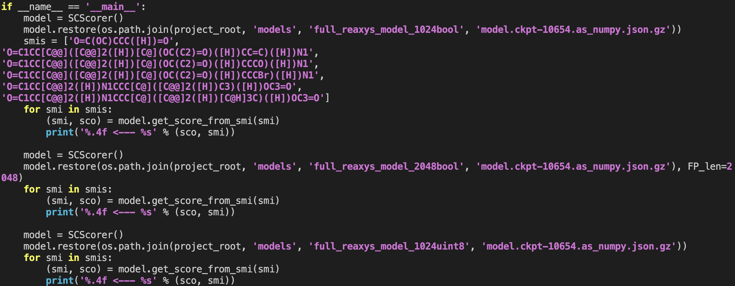

Slide 11
Interactive
Go to Week13/Exercise1
git clone https://github.com/connorcoley/scscore.git
cd scscore
python scscore/standalone_model_numpy.py
Now change the smiles in standalone_model_numpy.py to the smiles in smis.smi by:
cat ../../smis.smi | sed "s/^/'/g" | sed "s/$/',/g”
replace the smiles in the script by the printed smiles.
python scscore/standalone_model_numpy.py

Slide 13
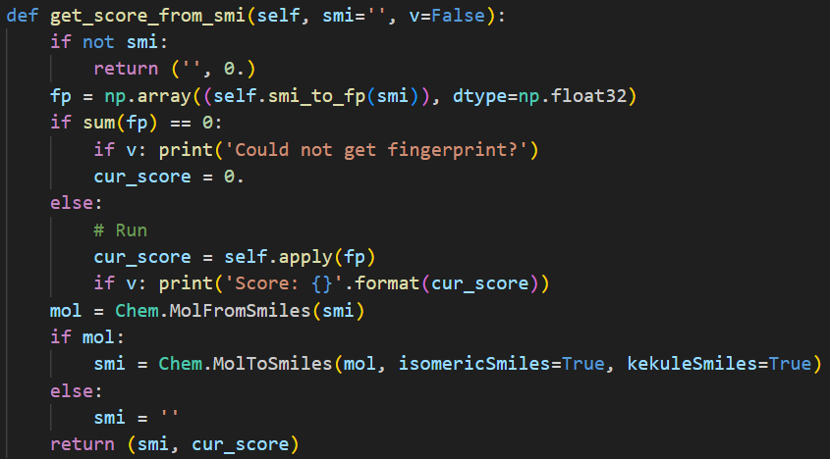
Artificial neural network

Slide 14
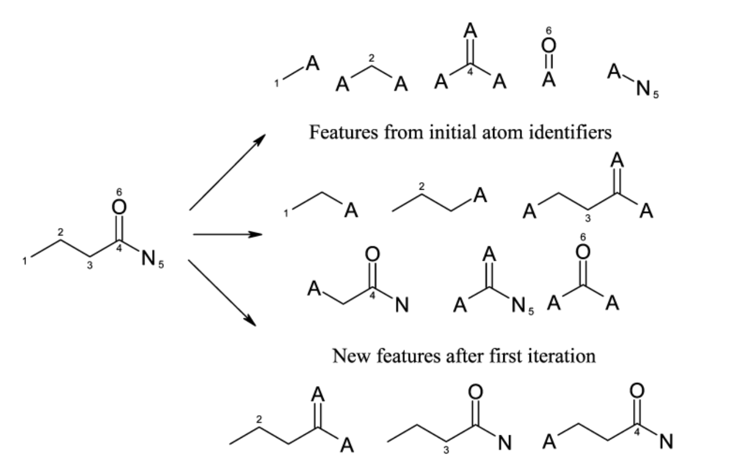
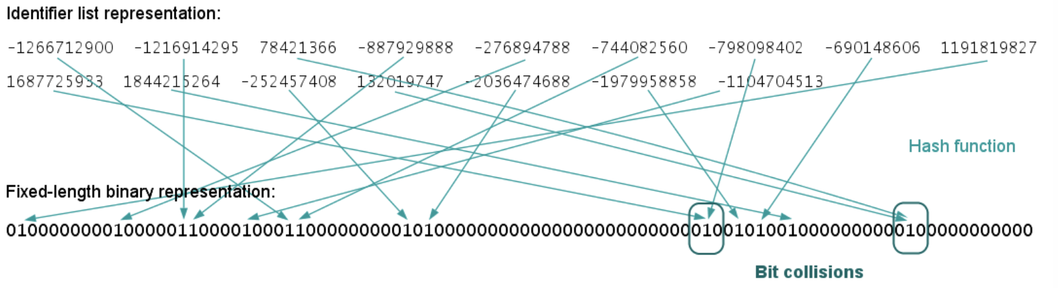
Molecular Fingerprint
Molecule fingerprints are binary bit strings that represent the structural features of a molecule. Uses a circular neighborhood around each atom in a molecule to capture local structural information.

Slide 15
Artificial neural network

Slide 16
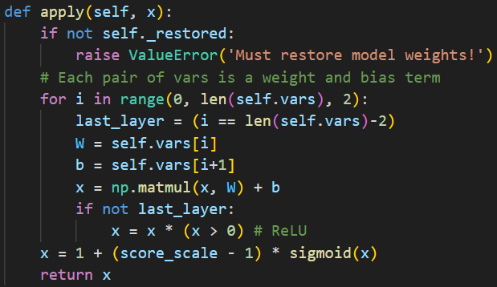
Artificial neural network

Slide 17
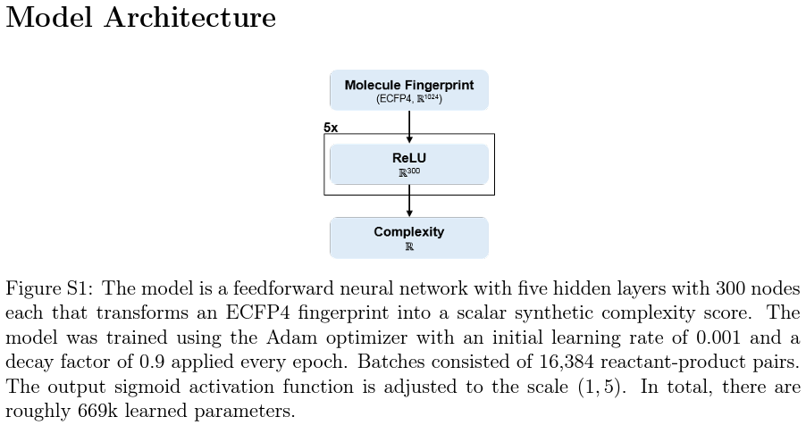
Artificial neural network

Slide 18
Artificial neural network
= 12
= [0, 2, 4, 6, 8, 10]
(five hidden layers +
1 output layer)

Slide 19
Artificial neural network

Slide 20
Artificial neural network
y
W
x
b
=
+
300 x 1
300 x 1024
300 x 1
~ y = mx + b
1024 x 1

Slide 21
Artificial neural network
1 x 1
1 x 300
300 x 1
1 x 1
y
=
W
x
+
b

Slide 22
Artificial neural network

Slide 23

Artificial neural network

Slide 24
Artificial neural network

Slide 25
Artificial neural network

Slide 26
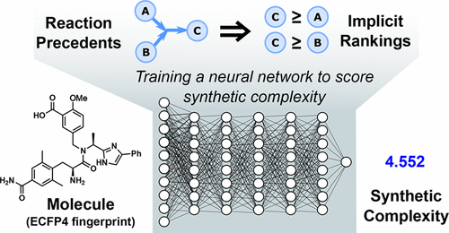
Artificial neural network

Slide 27
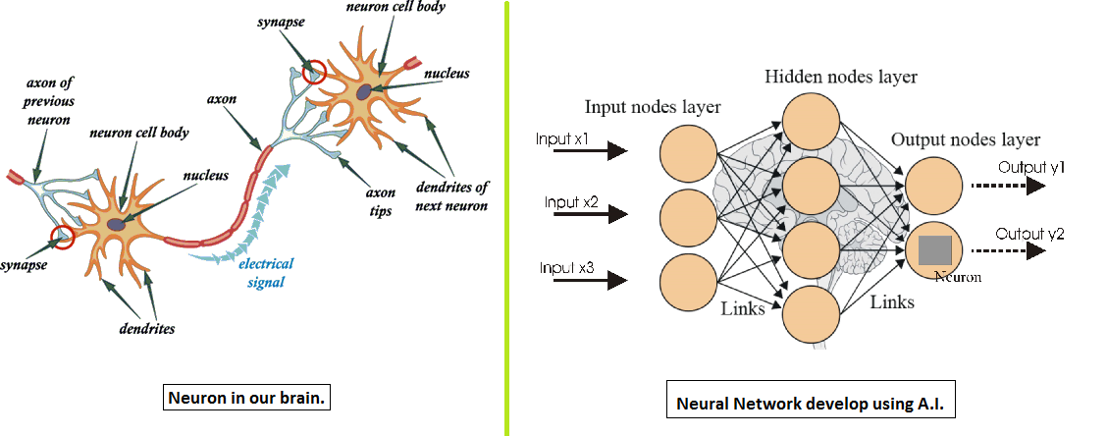
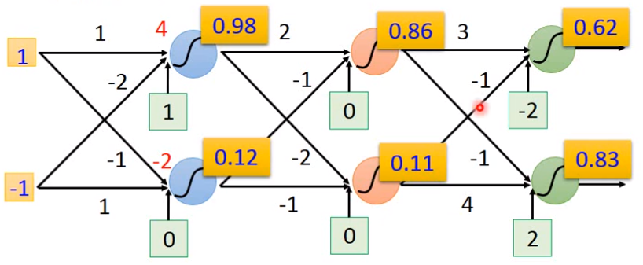
Artificial Neural Network

Slide 28
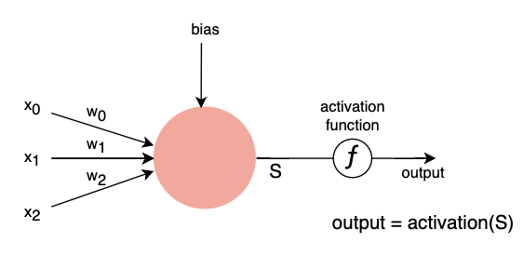
Activation Function
Activation functions are important in machine learning because they introduce nonlinearity, allowing models to learn complex patterns and make non-linear predictions. They also help propagate gradients during training and control the output range of the model for better interpretation and performance.

Slide 29

Activation Functions

Slide 30
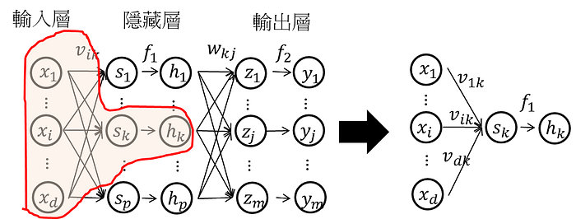
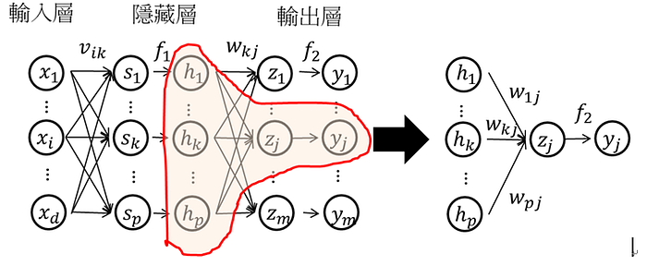
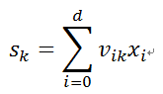
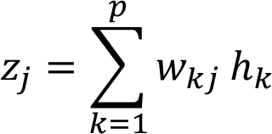
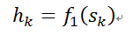
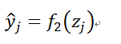
Forward Propagation
Through activation function
Output =

Slide 31
Artificial neural network

Slide 32
Artificial neural network
(1024x300+300)
+ (300x300+300) + (300x300+300) + (300x300+300) + (300x300+300)
+ (300x1+1)
= 669,001 ~ 669k

Slide 33
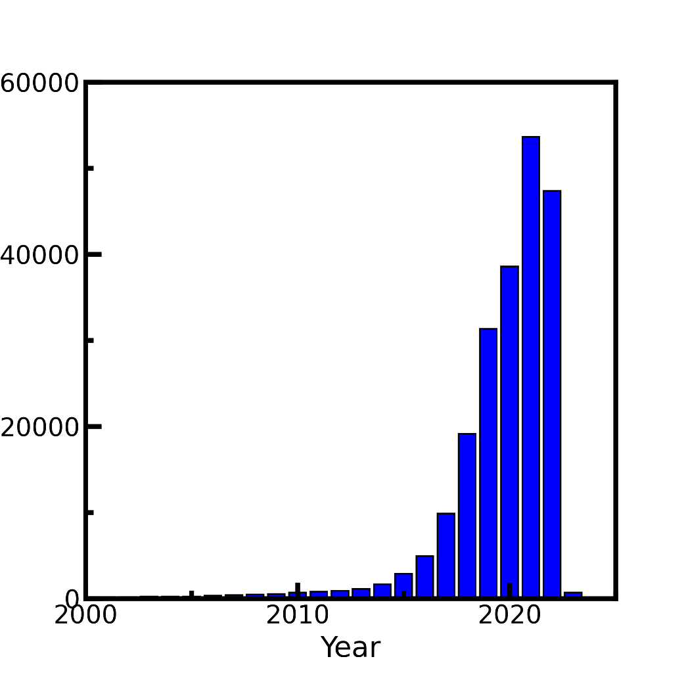


Game changed in 2009
#Publication mentioning deep learning
CUDA introduced in 2007
Publication counts: Web of science, keyword=‘Deep learning’. Accessed on 2022/11/22

Slide 34





Deep Learning Framework

Slide 35
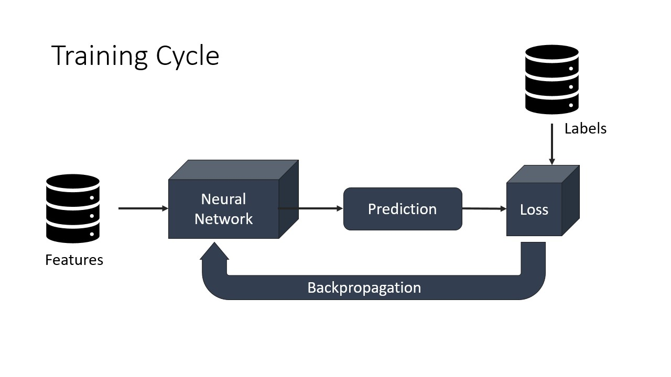
Interactive
Go to Week13/Exercise 2
Sbatch submit_training.sh
Training a model to predict molecules property
Follow slurm output by tail -f to see what’s happening.

Slide 36
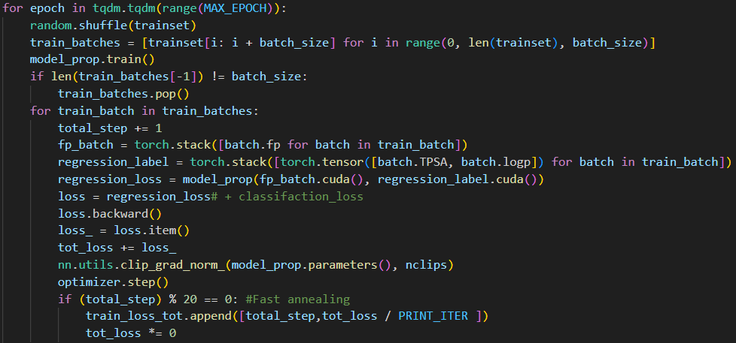
Neural Network Training

Slide 37
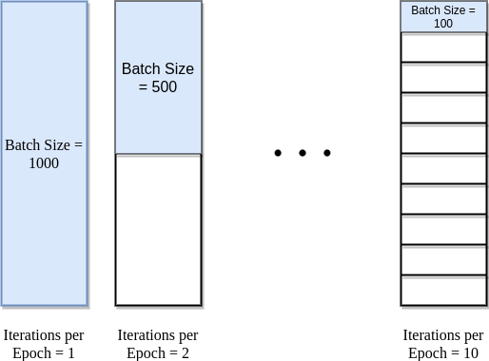
Details about training model
Dataset size = Iteration * Batch size （1 Epoch）Iteration = （Data set size / Batch size）* Epoch

Slide 38
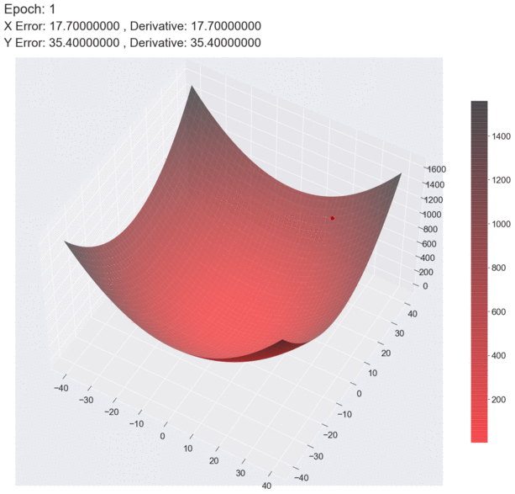

How batch size effect gradient descent
Batch size = 10
Batch size = 1
https://medium.com

Slide 39
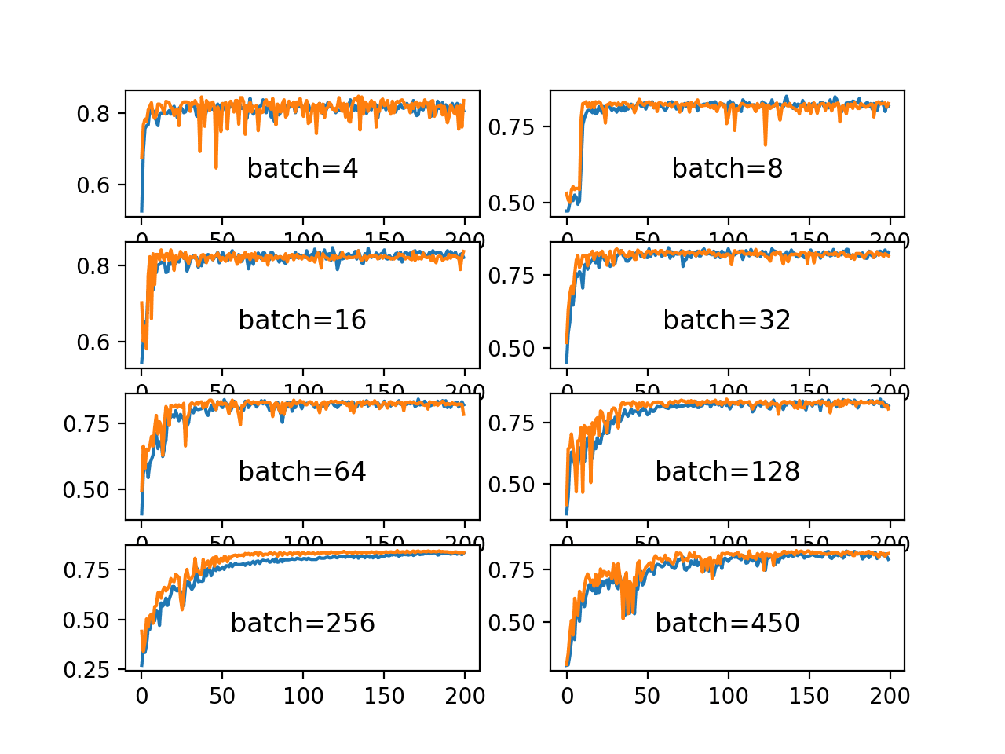
Does larger batch size always perform well?
Large batch size advantages: provide smoother and more stable gradients, which can facilitate convergence. Large batch size
Disadvantages: Reduce the randomness in each iteration during training, which can affect the model's generalization ability.

Slide 40
Neural Network Training

Slide 41
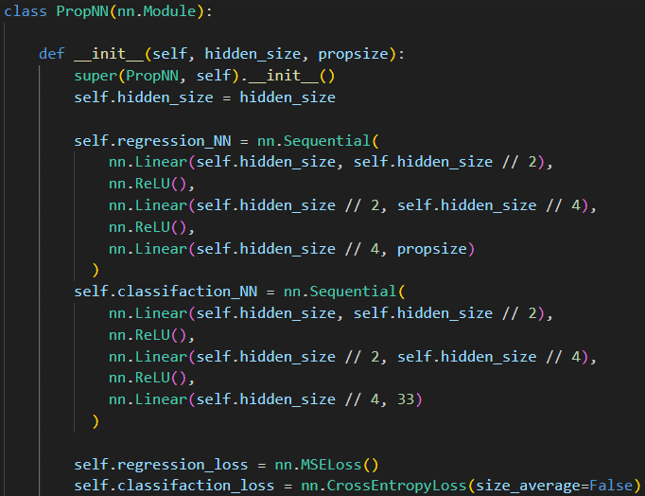
Neural Network Training
hidden_size = input_size = 128, 256, 512, or 1024

Slide 42
Network Architecture

Slide 43
Neural Network Training

Slide 44
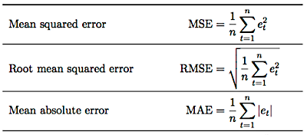
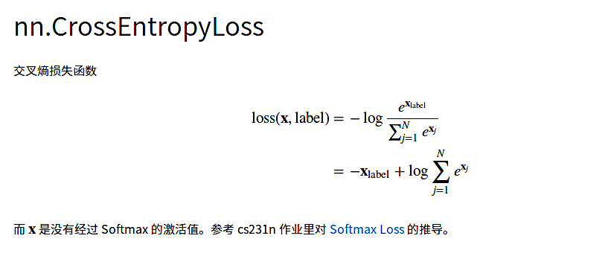
Loss Function
For regression case
For classification case

Slide 45
Neural Network Training

Slide 46
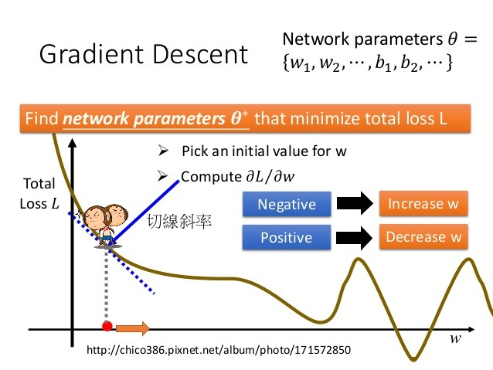

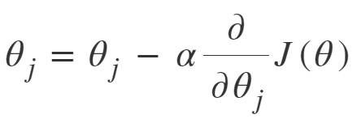
Gradient Descent
Gradient descent is an optimization algorithm used in machine learning to minimize the loss or error of a model. It iteratively adjusts the model's parameters by taking steps proportional to the negative gradient of the loss function. It aims to find the optimal values that minimize the error and improve model performance.
slope

Slide 47
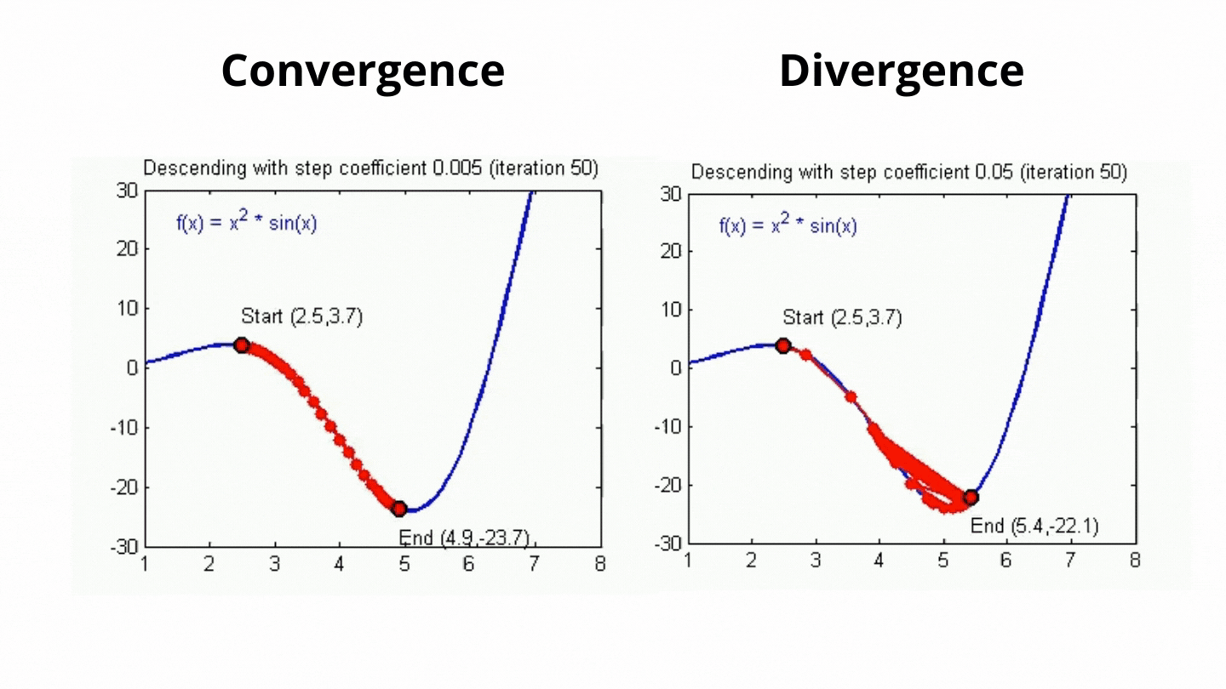
Learning Rate
Learning rate controls how much the parameters are adjusted based on the gradients of the loss function.
https://towardsai.net/

Slide 48
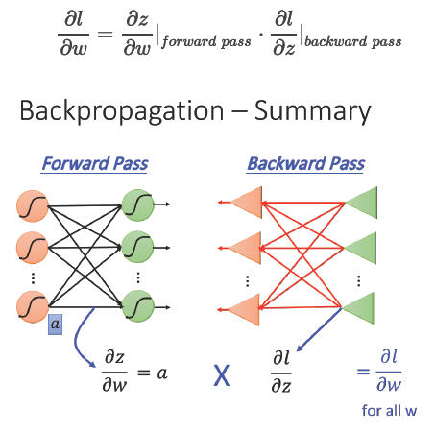
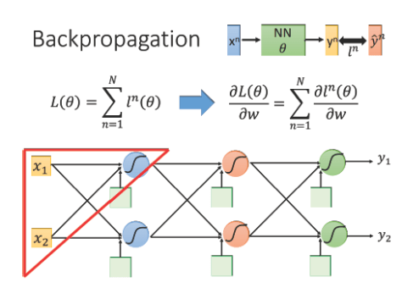
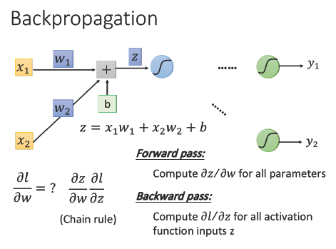
Backward Propagation
Notes:
loss function: L(θ) 等於所有的training data的loss總和
Forward pass 每一個neuron 的activation function 的output，就是他所連結的weight 的 ∂z/∂w
Backward pass 建一個與原來方向相反的neural network，它的三角形neuron的output 就是 ∂l/∂z，把通過forward pass 得到的 ∂z/∂w 和通過backward pass 得到的 ∂l/∂z 乘起來就可以得到 l 對 w 的偏微分 ∂l/∂w

Slide 49
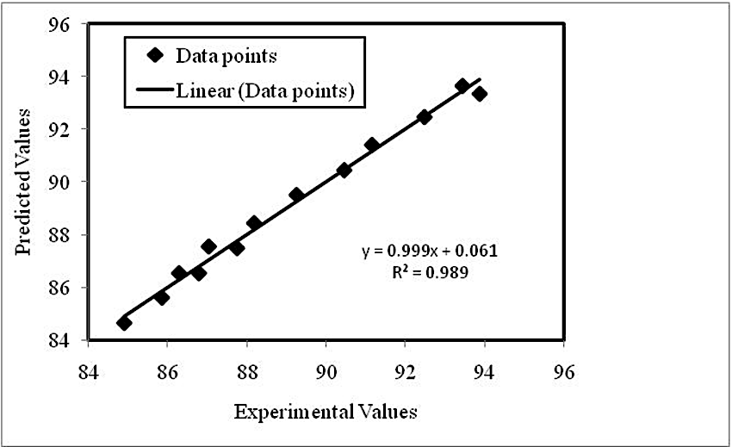

Parity plot
A parity plot is a scatterplot that compares a set of results from a training model against ground truth data. Each point has coordinates (x, y), where x is a true value and y is the corresponding value from the model.

Slide 50
Interactive
Go to Week13/Exercise 3
Click parity_plot.ipynb
Run kernel
Shown the parity of model prediction with ground truth
Analyzed the RMSE loss and MAE loss of model performance

